Slide 1
New School of Education Faculty Orientation

Slide 2
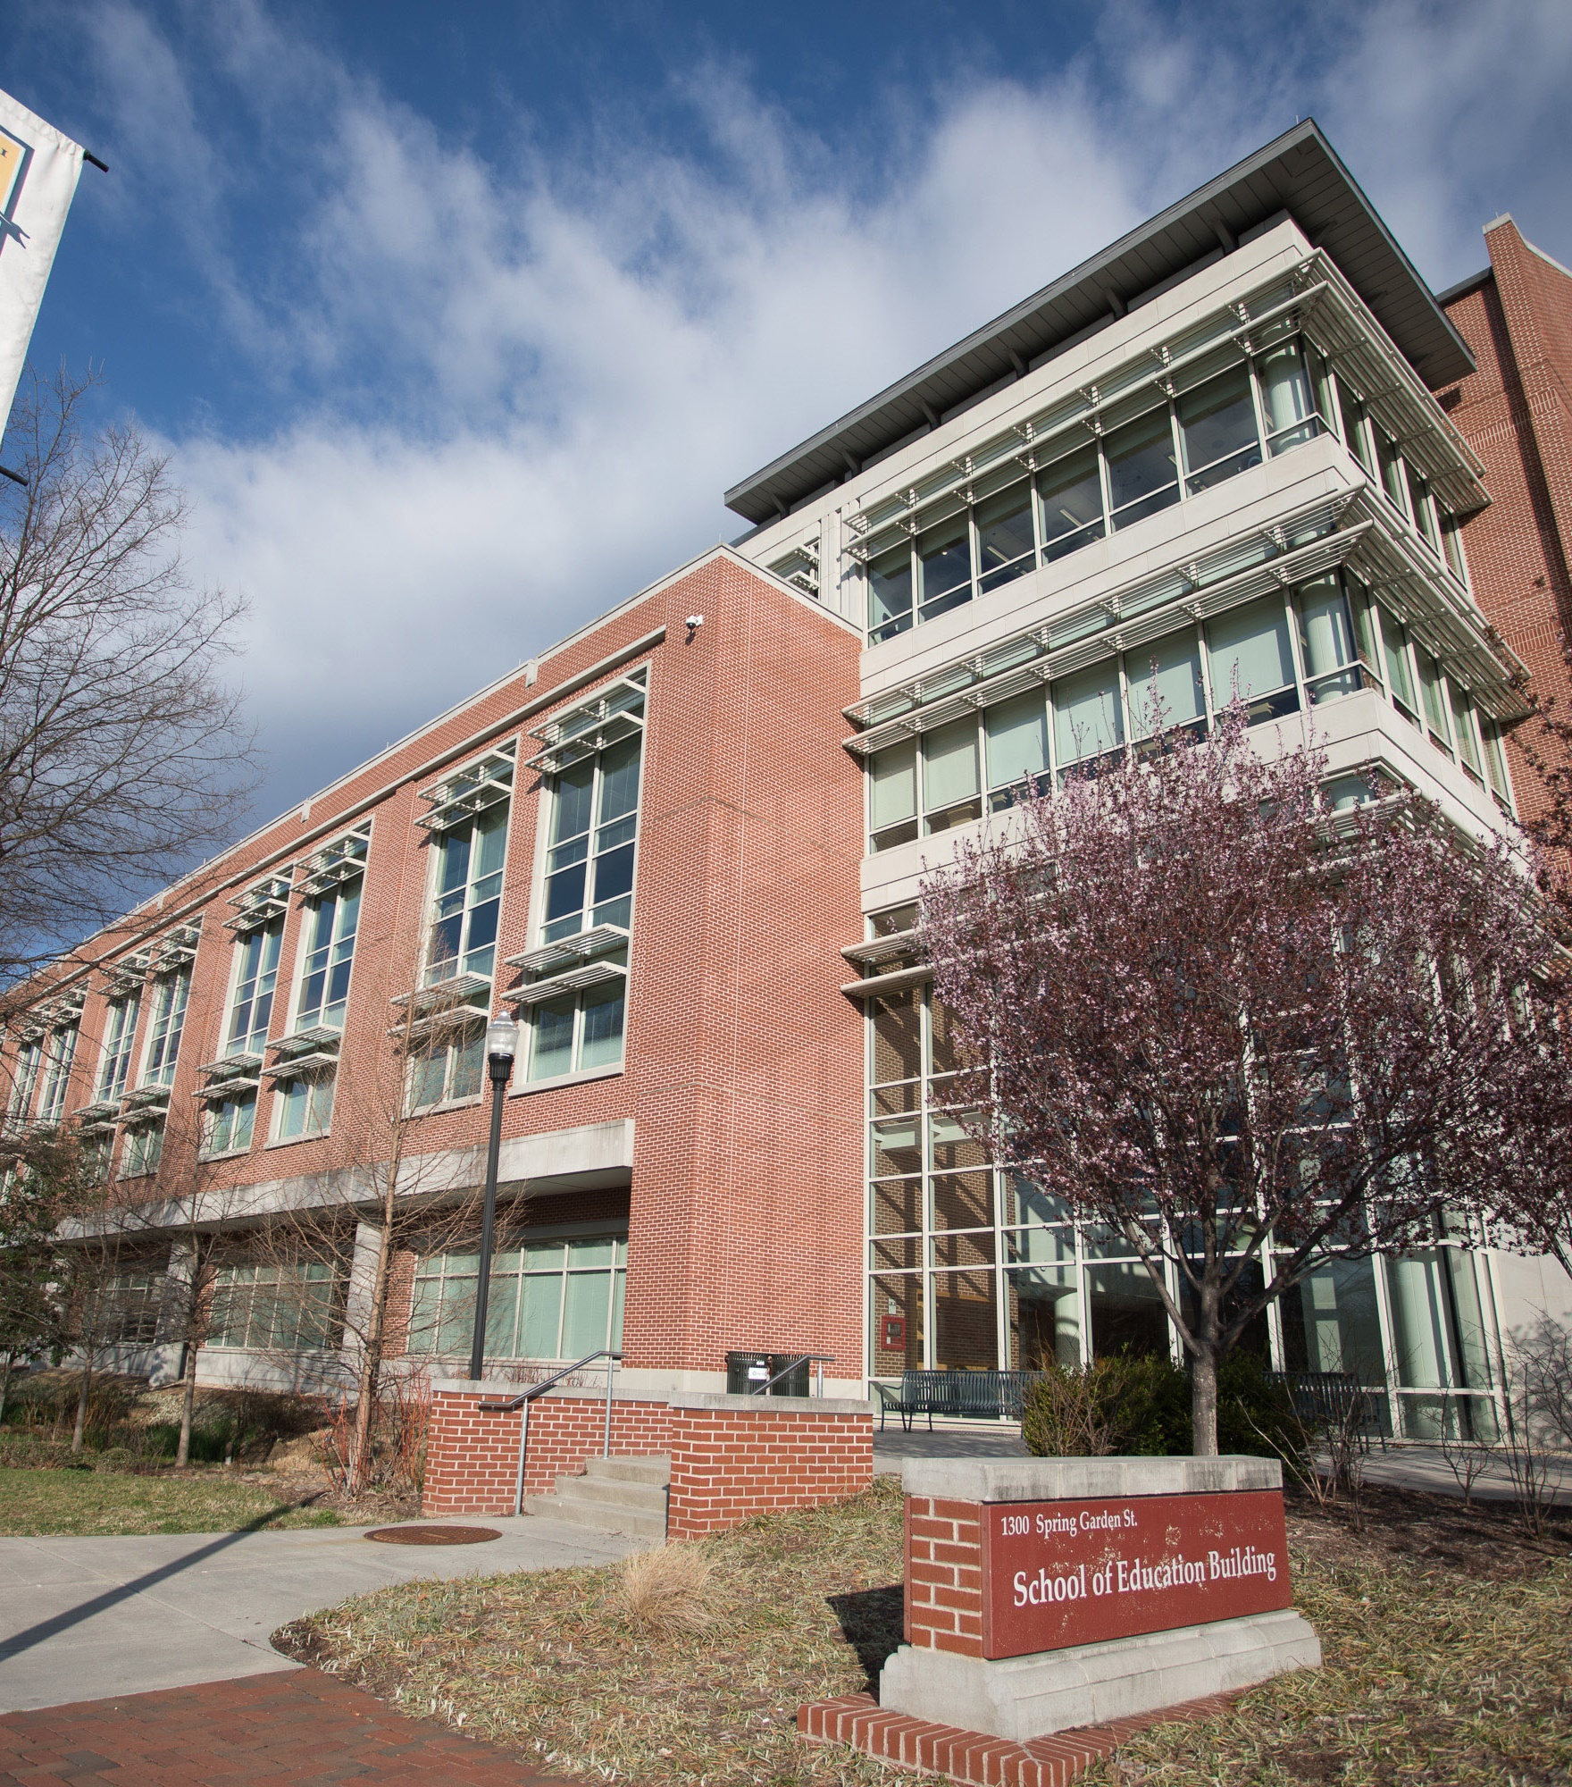
Welcome

Slide 3
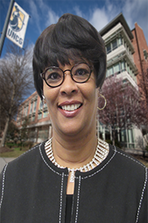
SOE Academic Affairs & Student Services
Jewell Cooper, Associate Dean of Academic Affairs and Student Services
Notes:
Welcome to the School of Education at the University of North Carolina at Greensboro. I am Jewell Cooper, Associate Dean of Academic Affairs and Student Services. I am attending a conference today and cannot be with you in person. Nonetheless, I want you to know how thrilled we are that you have joined us. No doubt, you had other institutions from which to choose to begin or continue your professional careers. However, you chose UNC Greensboro. Your choice makes the School of Education and the university very happy!
To ease your transition to the School of Education, The Office of Academic Affairs and Student Services – specifically the Office of Instructional Technology Support - wants to introduce to you people and services that could make your professional life less stressful. Today’s activities will include personnel and information from the following areas in the School of Education: The Dean’s office, Communications, Office of Research, Global Office, the Office of Student Services and Advising, the Teaching Resources Center and the SELF Design Studio as well as the Office of Instructional Technology Support. You will hear about the role of my office throughout the morning as information is couched within this morning’s various presentations. With so much information to consume in the coming days, we hope to assist you in putting a name with a face and the role the person has in the School of Education to assist you in becoming the best, most effective professional you can be.
Enjoy the morning’s activities. Let me know if I can assist you now and in the future. My office is located at 321 School of Education Building.
Best wishes for a successful academic year!!

Slide 4
SOE Dean's Office
Gabrielle Boyce
Executive Assistant to the Dean

Slide 5
https://spartancard.uncg.edu/get-a-card/#facstaff
Spartan ID
Notes:
The SpartanCard is your all-in-one campus ID card. In addition to serving as your ID, the SpartanCard is also your library card, your meal card, and a convenient form of payment across campus.
To get a SpartanCard, visit the SpartanCard Center, located in 106 Moran Commons (the UNCG Dining Hall). A SpartanCard representative is there to assist you from 8 am to 5 pm, Monday through Friday. To learn more about your SpartanCard, explore Using Your SpartanCard. Please be aware that replacement charges may apply if you are replacing an existing, lost, or stolen SpartanCard.
If you wish to submit a photo online instead of taking one in-office, please visit SpartanCard PhotoLink.

Slide 6
Classroom Reservations
https://euc.uncg.edu/reservations/

Slide 7
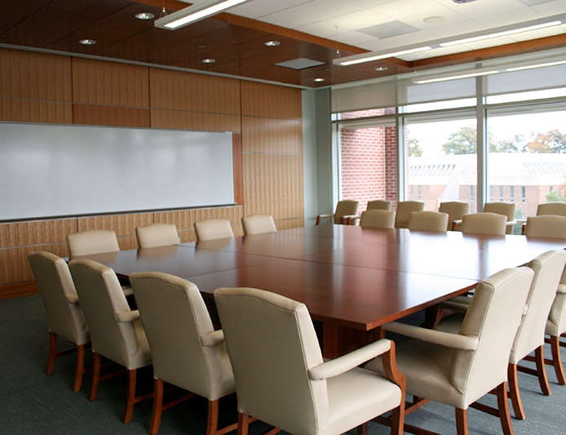
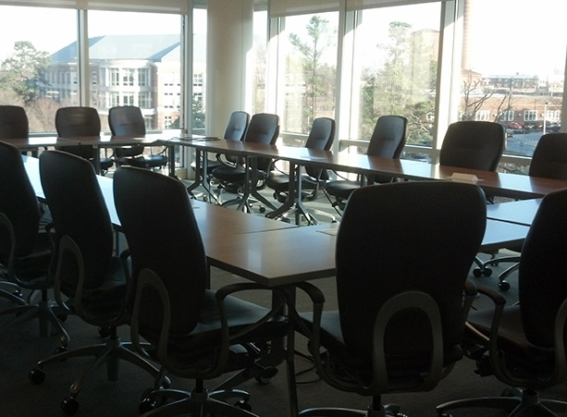
SOE Conference Room Reservations
go.uncg.edu/soeconferenceroom
Notes:
The School of Education (SOE) has four conference rooms that can be reserved for meeting purposes. Conference rooms in the School of Education building should be requested for meeting purposes only, NOT for classes to be held.

Slide 8
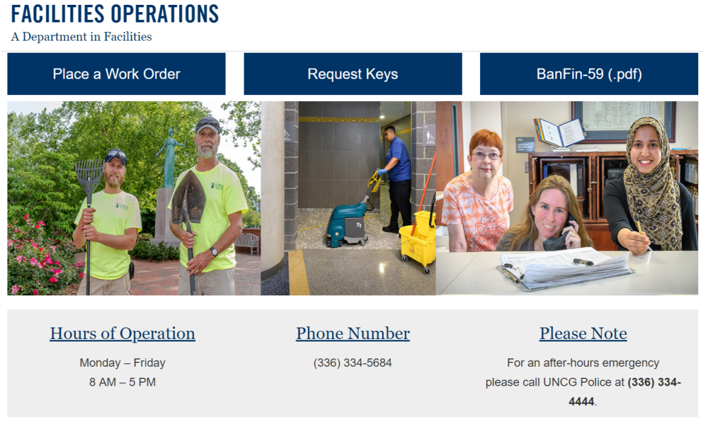
Facilities Operations
https://facoperations.uncg.edu/request-service/
Notes:
Facilities at the University of North Carolina at Greensboro is a diverse, environmentally and safety conscious, and effective organization comprised of innovative professionals whose mission is to deliver remarkable customer service in the planning, design, construction, maintenance and operations of university facilities, grounds and infrastructure.

Slide 9
SOE Communications
Rosalie Catanoso, Public Communications Specialist
Carla Wilson, Instructional Technology Consultant & Digital Media Specialist

Slide 10
Submit Communication Requests
Fill out the Communications Request Form http://go.uncg.edu/soecommrequest
Requests include
social media
email newsletter
press release
website newsfeed
Campus Weekly
Contact Info: rmcatano@uncg.edu
General questions
Miscellaneous requests
Scheduling meetings

Slide 11
SOE Social Media
Most immediate way to share information
Tag SOE accounts in your individual department’s posts
@uncgschoolofedu
Live coverage of events

Slide 12
Monthly Email Newsletter
Audience:
Alumni
Donors
Other schools within UNCG
Deans of other universities
Includes:
Student & faculty research (funded and unfunded)
Alumni news and updates
New scholarships and programs
Major events & announcements
Cook Society and other giving opportunities

Slide 13
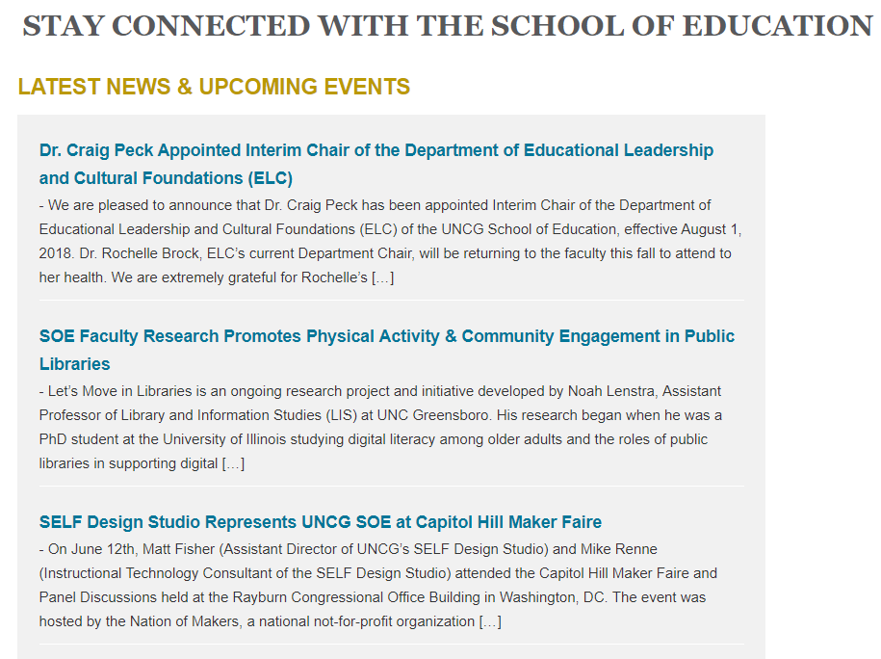
SOE Latest News & Upcoming Events
Useful for lengthier news and events
Coincides with social media
Drives traffic to website

Slide 14
SOE Digital Signage
Departments, centers, offices, and units within SOE
SOE faculty and staff
Registered student organizations
Campus Partners (other UNCG Departments, Offices, and groups)
go.uncg.edu/soesignage
Notes:
Two digital screens are available in the School of Education Building to provide information on (a) transformative educational experiences; (b) innovation and research and bridging discovery with teaching and practice; (c) the promotion of equity, diversity, and inclusion; and (d) events and activities fostering an engaged and collaborative community.

Slide 15
Division of Research, Discovery & Innovation (RDI)
Troy Sadler, Associate Dean for Research

Slide 16
Mission of RDI
Advance the quality, impact, and visibility of SOE research and other forms of scholarship
We accomplish this mission by running an Office of Research, housing some projects, and supporting special initiatives (e.g., Impact Through Innovation, Moss Street Partnership School)

Slide 17
Who does the RDI support? YOU
Does research have to be funded (or potential to be funded) in order to be supported by RDI? NO
Does RDI prioritize support for a particular approach to research (experimental designs or ethnographic work or historical inquiries)? NO
Does RDI only support faculty at a particular career stage? NO

Slide 18
RDI Staff
Troy Sadler, Associate Dean of Research
Deana Hasty, Pre-Award Research Administrator
Allyson Lugo, Post-Award Research Administrator
Adam Shull, MSPS Grant Writer

Slide 19
Services provided by the Office of Research
Support grant administration
Manage finances
Help hiring processes
Process tuition and assistantship expenses
Coordinate activities for project managers
Provide consultation for development of research plans

Slide 20
Services provided by the Office of Research
Help search for funding opportunities
Support proposal submission
Review funder policies
Provide boilerplate information
Draft budgets and justifications
Assemble proposal packages
Serve as a liaison with UNCG Office of Sponsored Projects and Office of Contracts & Grants

Slide 21
RDI Special Initiatives
Impact Through Innovation (ITI) https://soeinnovation.uncg.edu/
Coalition for Diversity in Language and Culture (CDLC) https://cdlc.uncg.edu/
Real World English Program https://research.uncg.edu/spotlight/real-world-english/

Slide 22
UNCG Supports for Research
Office of Research & Engagement, Vice Chancellor Terri Shelton https://research.uncg.edu/
Institute for Community & Economic Engagement https://communityengagement.uncg.edu/
Office of Research Integrity https://integrity.uncg.edu/
Office of Sponsored Programs https://sponsoredprograms.uncg.edu/
Researcher Zone https://research.uncg.edu/researcher-zone/

Slide 23
UNCG Research Centers & Networks
Center for Youth, Family, and Community Partnerships (CYFCP)
SERVE Center
Child and Family Research Network (CFRN)
Collaboration for Research on Health Improvement Network
LGBTQI Education and Research Network (LEARN)
Research and Instruction in STEM Education (RISE)
Violence Prevention Research Network

Slide 24
IRB
CITI training https://about.citiprogram.org/en/homepage/
IRBIS https://uncg.myresearchonline.org/irb/

Slide 25
Office of Research & Engagement Workshops
Find out about upcoming events - https://research.uncg.edu/events/
Show me the money! Locating grant funding opportunities
Applying for internal research awards
UNCG Library series on research
Grant writing for maximum impact
Steps towards successful submissions of grant proposals

Slide 26
Internal Research Support
https://research.uncg.edu/internal-grants-and-awards/
New Faculty Research Awards (@UNCG < 3 years) - $5K for individual and $10K for collaborative proposals
Regular Faculty Research Awards
Faculty First Awards
Community-engaged Pathways and Partnership Grants
International Research Grants
UNCG Libraries Digital Partners

Slide 27
Thank you & welcome!
Troy Sadler
tdsadler@uncg.edu
SOEB 320A
336-256-0154

Slide 28
SOE Global
Dr. Ye “Jane” He, Associate Professor, TESOL

Slide 29
STAY CONNECTED & UPDATED
http://soe.uncg.edu/global/
Email: soeglobal@uncg.edu
Facebook Group: SOE Global

Slide 30
SOE International Committee
Share
Share resources for internationalization
Foster
Foster a welcoming and supportive environment for SOE international students, visitors, and scholars
Promote
Promote SOE international collaborative opportunities
Notes:
Share resources for internationalization: The committee strives to enhance the awareness of existing international, national, regional and local resources for internationalization among SOE faculty, staff and students.
Foster a welcoming and supportive environment for SOE international students, visitors, and scholars: The committee provides support and network opportunities for SOE international students, visitors, and scholars; and offers education and awareness regarding international access, equity, and support issues.
Promote SOE international collaborative opportunities: The committee offers resources and support for SOE faculty, staff, and students who are interested in leading and/or participating in study-abroad programs, exchange programs, and other international collaborative teaching, research, and service opportunities.

Slide 31
SOE International Activities
Incoming
International Degree-Seeking and Exchange Students
Visiting Scholars
Short-Term Visiting Program
International Visitors
Outgoing
Faculty/Scholar Abroad
Short-Term and Semester/Year-Long Study Abroad
Local Engagement
Collaboration with local K-12 schools
Greensboro Chinese School

Slide 32
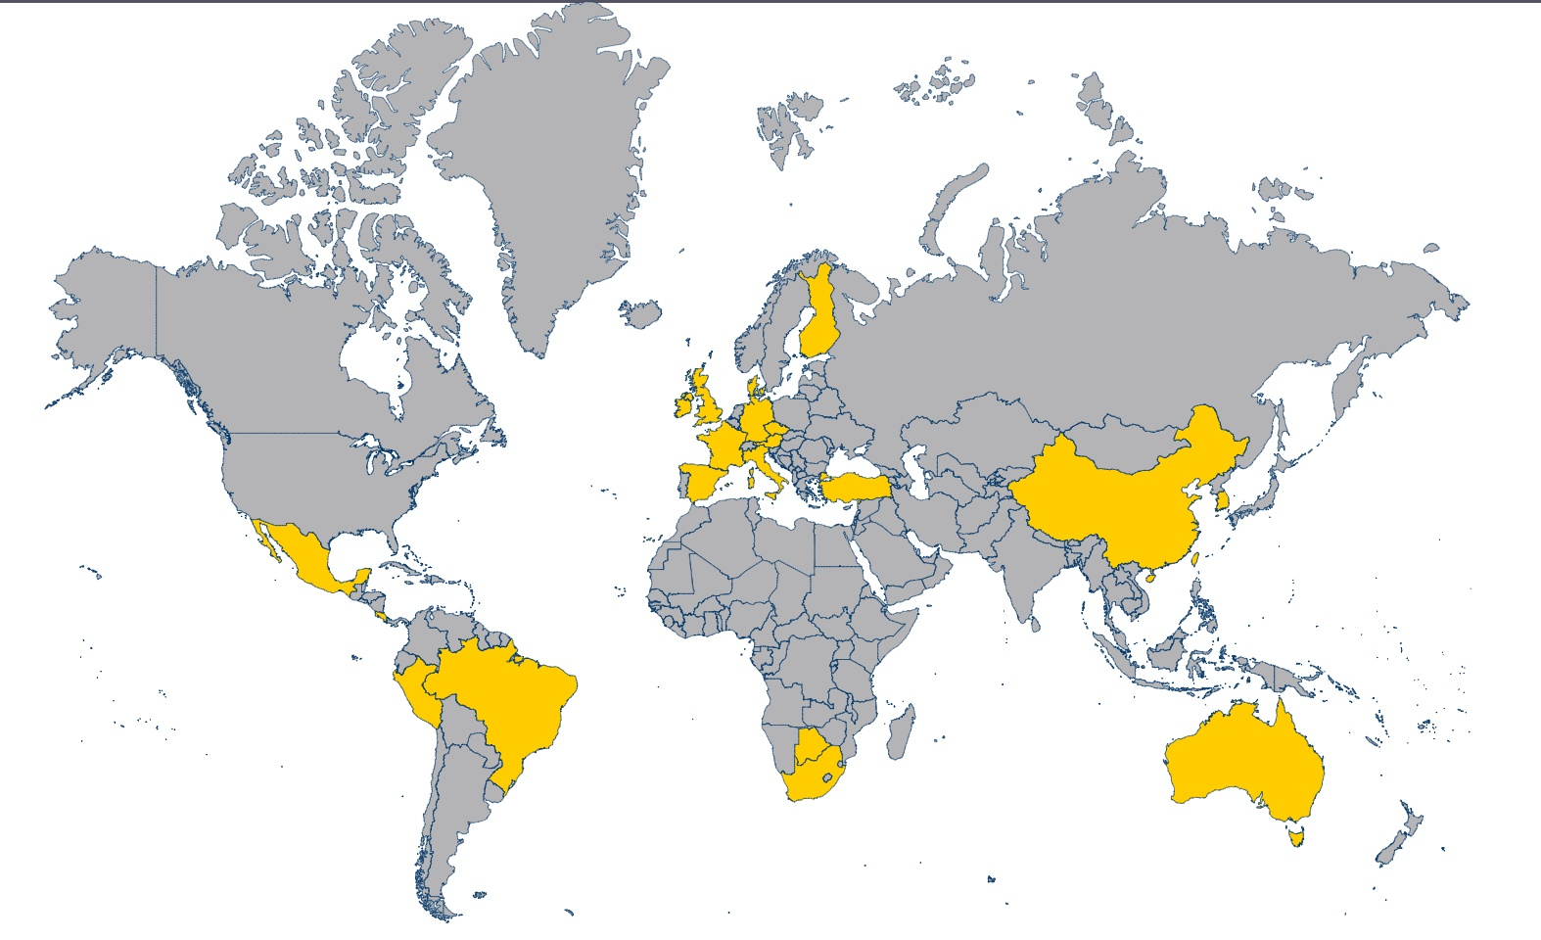
SOE Study Abroad
Australia
Austria
Botswana
Brazil
China
Czech Republic
France
Italy
Peru
Mexico
New Zealand
Ireland
South Africa
Spain
Taiwan
Turkey
United Kingdom

Slide 33
Office of Student Services and Advising (OSS)
Ciara Marable, Associate Director for Office of Student Services

Slide 34
Services Provided
Academic Advising
Alternative Licensure Options & Advising
Internship/Placement
Application process management
Teacher-based Student Organizations
Licensure Inquiries
Scholarships
Substitute/Urgent Hire Request
Student Data Management

Slide 35
Contact Us
Office Hours
Monday-Friday 8:00am-5:00pm
Walk-in hours (Academic Advising)
Tuesdays 2:00-5:00 pm
Peak Advising times
Fall Advising: October 1-December 1
Spring Advising: March 1-May 1
Thursdays 9:00am-12:00pm
Rooms 124-142 on the first floor of SOEB

Slide 36
Meet our Staff
Director: Dr. Jacqueline Dozier
Associate Director: Ciara Marable
Assistant Director: Brian Strickland
Assistant Director: Terence Polk
Administrative Associate: Angela Gantt
Alternative Licensure Advisor: Amanda Shirk
Placement Coordinator: Judy Pelance
Student/Data Manager: Carol Griggs
Recruiter: Ashley Hughes

Slide 37
Student/Data Manager: Carol Griggs
Processes applications
Maintains various databases
Provide data

Slide 38
Placement Coordinator: Judy Pelance
Liaison
Placements

Slide 39
Recruiter: Ashley Hughes
Coordinates recruitment activities
Collaborates on admissions events and recruitment activities
Initiates contact with potential applicants

Slide 40
Advising in OSS
OSS provides academic advising for undergraduate students
Elementary Education-Terence Polk
Middle Grades-Brian Strickland
Dual Major-Brian Strickland & Dr. Jacqueline Dozier
Special Education-Brian Strickland
Secondary Teacher Education-Ciara Marable
Alternative Licensure-Amanda Shirk

Slide 41
The Advising Process
At least once a semester required meeting
Available for questions via email, phone, or google chat
Check out our website for helpful information: oss.uncg.edu

Slide 42
What’s covered in an advising session?
Class Schedule
Admission requirements to Teacher Education
Licensure requirements
SOE and university policies
Degree Works
Progress towards graduation
Course issues and solutions
Academic resource referrals-tutoring, counseling, disability services
Campus resource referrals-financial aid, registrar, library
Starfish raised flags
Personal issues and concerns related to college navigation

Slide 43
Admission to Teacher Education
Must have a 3.0 cumulative GPA
Undergraduate programs
Cohort based
Once a year admission
Secondary Teacher Education
Admitted once all requirements are met
Criminal background check
Praxis Core Academic Skills or exemption with SAT or ACT Scores
Application to the program
Program dependent: Passing grades on specific teacher education courses

Slide 44
Alternative Licensure
Advisor: Amanda Shirk
Discuss the options
Add a license-doctoral students
- NC Teach
- Licensure Only
- PAIL
- MAT
Interest include:

Slide 45
Alternative Licensure Programs
Licensure Only
Undergraduate
Music (K-12)
Health & Physical Education (K-12)
Art Licensure (K-12)
NC Teach
Graduate
PAIL (Post-Baccalaureate Alternative Initial Licensure)
MAT Masters of Arts in Teaching
Middle Grades 6-9 Math
Comp Science
Language Arts
Social Studies
High School 9-12 Math
Comp Science
English
Social Studies
Latin
Spanish
French
Special Education: General Curriculum
Concentrations
Elementary Education
Middle Grades Education
Science Education
Social Studies Education
TESOL

Slide 46
Licensure Updates
Licensure Exams
DPI Licensure application
EdTPA
OSS professional development workshop

Slide 47
Student Issues
Dispositions
Assessed three times using CDAP form
Professional Improvement Plan
Dismissal from program
Code of Conduct
UNCG Dean of Students Office
Who handles violations?
sa.uncg.edu/dean
Appeals
Right to appeal
Must adhere to University’s grade appeal policy
Process for appeals
Faculty Member
Department Chair
SOE Associate Dean

Slide 48
Teaching Resource Center (TRC) & SELF Design Studio
Lori Sands, Director of Teaching Resource Center & Self Design Studio

Slide 49
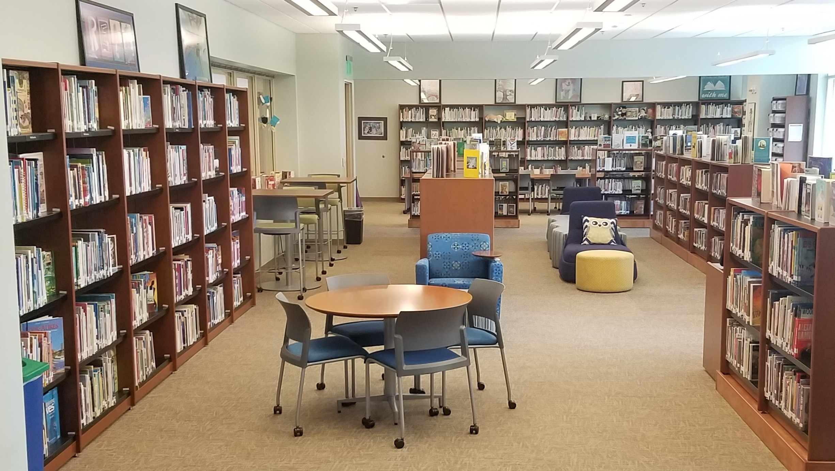
Teaching Resource Center (TRC)
Room 310, School of Education Building
Notes:
The Teaching Resources Center provides instructional materials, equipment, and services that support the students, faculty, and staff of the School of Education, the UNCG campus, and teachers throughout the Piedmont Triad.

Slide 50
TRC & SELF Design Studio Resources
Children's and Young Adult Literature
PK-12 Teaching Resources
Professional Collection
Laptops
iPads
Cameras and Video Equipment
Audio Equipment
TRC Classroom 302
Kits, Games, Manipulatives
Other Instructional Technology
Notes:
The TRC serves as a model school library media center offering a large collection of picture books, young adult fiction, nonfiction, audiobooks, board books, big books, kits, manipulatives and DVD’s. We also have professional resources useful in preparing lesson plans, all K-12 state adopted textbooks, and study guides for NC teacher exams.

Slide 51
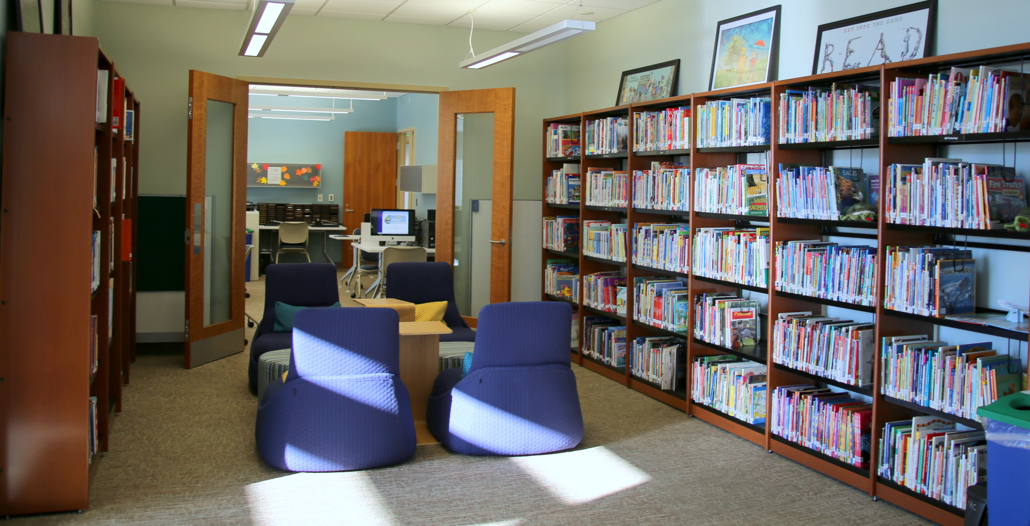
TRC & SELF Design Studio Services
Class orientation & collaborative instruction sessions
Bibliographies of TRC resources
Laminator, book binder, poster printer, Ellison, Cricut, 3D printer, laser cutter

Slide 52
SELF Design Studio
Notes:
(https://vimeo.com/111933051)
The SELF (Student Educator Learning Factory) Design Studio serves as a makerspace where School of Education faculty and students learn and create with hands-on resources and activities. Collaboration with area teachers and PK-12 students helps prepare pre-service teachers to become educational leaders who will engage students with innovative and creative learning models.

Slide 53
Office of Instructional Technology Support
Sandra Bates-Hart, Director of Instructional Technology
Carla Wilson, Instructional Technology Consultant & Digital Media Specialist

Slide 54
Our Services
SOE Technology
Instructional Technology Support
Computer Lab reservations
Web conference equipment checkout
SOE Digital Signage
SOE Website

Slide 55
Technical Support
Technical assistance
Hardware
Software
Connectivity issues
etc.
Email soe-tech-l@uncg.edu
include as much information about your request as possible
Requests will notify Bob Englert, Technology Analyst for the School of Education

Slide 56
Reserve & Checkout
Computer Labs
Lab 007 (20 Dell Desktops)
Lab 221 (14 Dell Desktops)
Lab 407 (20 iMacs)
Laptop Carts
Cart #1 (30 Dell Laptops)
Cart #2 (30 Dell Laptops)
Video Conference Equipment
1-4 People
1-6 People
6-10 People
10-25 People
Notes:
The office of Instructional Technology Support has computer labs, mobile laptop carts, and video conferencing equipment (audio and video) available for checkout by SOE faculty and staff.

Slide 57
Online assessment system
Collects, organizes and stores student's licensure requirements
How to access: https://www.watermarkinsights.com/

Slide 58
Core Technology
Canvas
WebEx
Box
Google Apps for Education
Office 365
SoftChalk
Notes:
We are actively involved with promoting technical competence, awareness, and skill-building throughout our educational programs, emphasizing the benefits that technology can bring to the classrooms by promoting active, participatory learning. Our mission is to assist SOE faculty and staff to effectively integrate technology into their teaching and learning.

Slide 59
Consultations
Recommendations for student engagement and assessment
Suggestions for streamlining course management and efficiency
Advice for selecting and implementing learning tools
Consultations for customized services
Notes:
The Instructional Technology Support team provides, one-on-one consulting to faculty who want to reflect on their teaching and the effect that it has on learning in their classes, design a new course, develop an existing course into a new format, assess student learning, or incorporate new technology tools into their courses.

Slide 60
Workshops & Training
Individual consultations
Small group requests
Online training materials
Self-paced training materials
Scheduled workshops
“HOW-TO” demonstrations
Notes:
The office of Instructional Technology Support is actively involved with promoting technical competence, awareness and skill-building throughout our educational programs, emphasizing the benefits that technology can bring to classrooms by promoting active, participatory learning.
We offer a variety of computer-related training services, including individual consultations, scheduled workshops, “HOW-TO” demonstrations, as well as online training materials for SOE faculty and staff. We provide workshops rooted in our core technology but as the technology needs of the SOE mature and grow, our workshops and training opportunities will strive to meet the new challenges of our expanding technological environment.

Slide 61
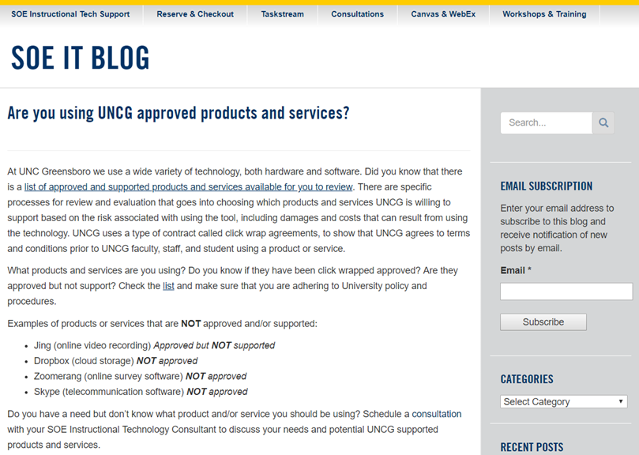
Follow the SOE IT Blog
https://soeitblog.uncg.edu/

